Slide 1

Bridging Curriculum and Industry
Identifying Applied Computer Science Concepts in a Software Internship and Designing a Containerization, Kubernetes, and Scalability Laboratory

Slide 2
Motivation & Purpose
Which Texas State CS concepts are actually used on the job?
Which important industry skills were missing from my coursework?
Goal: compare the curriculum to real internship work
Show where classroom learning has direct value — and where gaps exist

Slide 3
Approach & Methodology
Independent online research
Mentorship from my internship's cloud architect
Mapped internship tasks to specific course concepts
Milestones:
Define scope → document internship work
Identify concepts used → identify gaps
Design an assignment for the biggest gap → report & present

Slide 4
Curriculum Concepts I Used at Work
Git — branching, pull requests, code review
Agile & Jira — sprints, stand-ups, issue tracking
Object-Oriented Programming — maintainable code structure
APIs & web services — building and consuming REST endpoints
Programming & data structures — application logic and data handling
Software engineering — design, testing, documentation, collaboration
The fundamentals transferred directly and made me productive

Slide 5
The Gap — What Wasn't Taught
Docker & containerization
Multi-container composition with Docker Compose
Persistent state & data volumes
Horizontal scalability
Container orchestration with Kubernetes
Cloud deployment (Azure AKS + Container Registry)
Automatic scaling (HPA + KEDA)
Central to modern industry — but absent from my coursework

Slide 6
From Analysis to Action
Naming the gap isn't enough — the real value is closing it
The study pivoted from cataloging missing topics to building a solution
A concrete, teachable assignment a professor can assign
Goal: give students hands-on containerization & Kubernetes before the workplace

Slide 7
The Deliverable — A Three-Phase Lab
Phase 1: Docker fundamentals
Phase 2: Multi-container app (API + worker + MongoDB)
Phase 3: Kubernetes on Azure with automatic scaling
Complete line-by-line documentation and reproducible step-by-step guides

Slide 8
Phase 1 — Docker Fundamentals
Gives a background for containers & containerization.
Build and run a container from a Dockerfile
Pull a public image(MongoDB) and run the container.
Learn images, layers, ports, and the container lifecycle
Create a basic composition
Establishes the foundation for everything that follows

Slide 9
Phase 2 — Multi-Container Application
Express web API + background worker + MongoDB database
Docker Compose: shared network, environment variables, persistent volume
Producer/consumer flow:
API accepts a prompt and queues a job
Worker processes the job and writes the result back
Demonstrates real service-to-service communication

Slide 10
Phase 3 — Kubernetes & Scalability on Azure
Push images to Azure Container Registry (ACR)
Deploy the same app to Azure Kubernetes Service (AKS)
Objects: Deployments, StatefulSet, Services, PersistentVolumeClaims
Public access via a LoadBalancer + persistent cloud storage
Demonstrate horizontal scaling using KEDA and HPA

Slide 11
The System at a Glance
Browser
(user)
LoadBalancer
api-service
API pods
api-deployment
MongoDB
job queue
Worker pods
worker-deployment
HPA
scales on CPU
KEDA
scales on queue depth
Flow: the browser hits the API through a public load balancer; the API queues jobs in MongoDB; workers pull jobs from the queue and write results back.

Slide 12
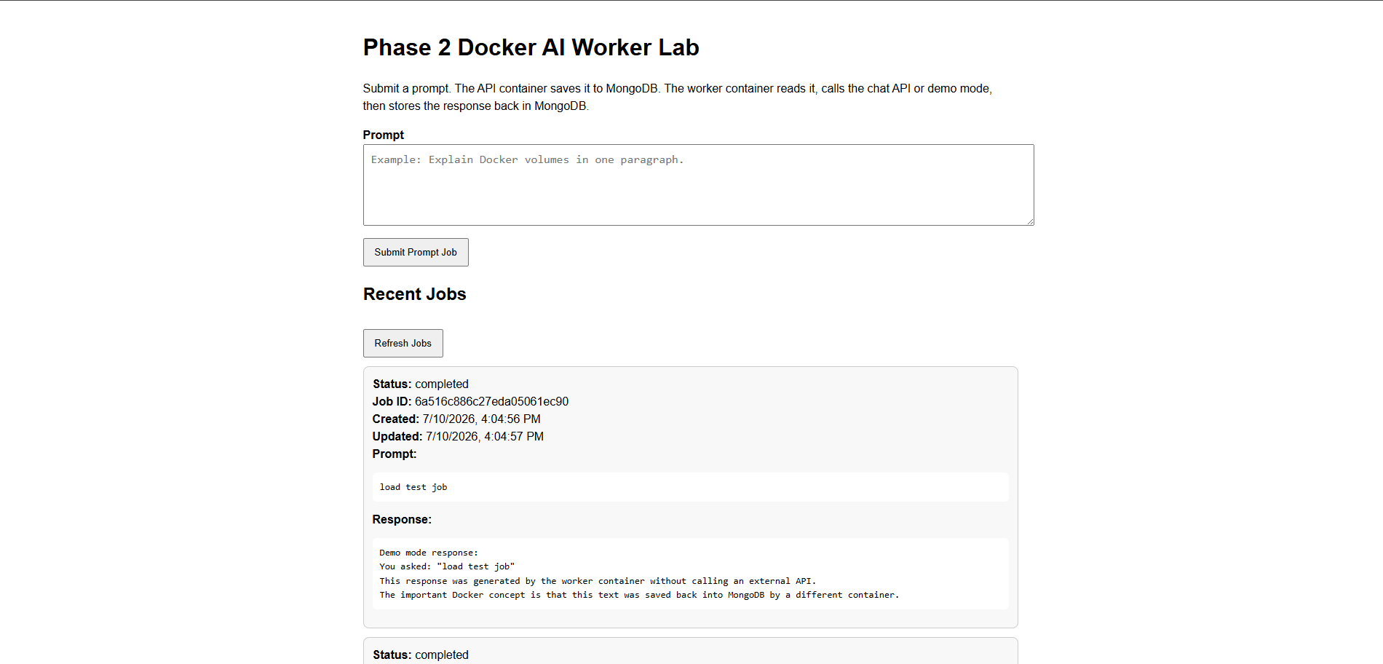
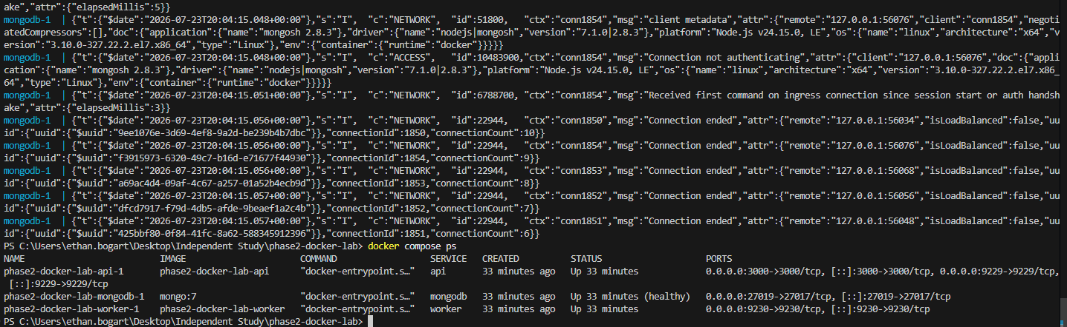
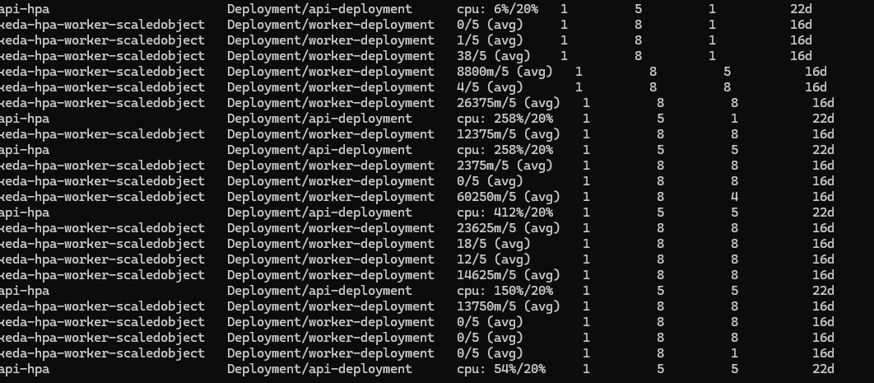
The Labs Running
Phase 2 — web app
Phase 2 — containers
Phase 3 — autoscaling

Slide 13
Key Concept — Match the Scaling Signal to the Workload
The API is CPU-bound under request load
→ CPU-based Horizontal Pod Autoscaler (HPA)
The worker mostly waits on external calls (very low CPU)
→ Scale on job-queue depth with KEDA, not CPU
Watch pods scale up under load, then back down when idle

Slide 14
Autoscaling in Action
API pods
(CPU-based HPA)
1
up to 5 pods under request load
Worker pods
(KEDA queue-based)
1
up to 8 workers as the job backlog grows
Load rises → pods are created (Pending → ContainerCreating → Running); load stops → pods scale back down.

Slide 15
Conclusion & Future Work
Curriculum delivers strong fundamentals: Git, Agile, OOP, APIs, software engineering
Clear gap: containerization, scalability, and Kubernetes
Deliverable: a ready-to-use, industry-relevant teaching lab
Future work:
Pilot the lab in a course and gather feedback
Add a CI/CD phase, automated grading, and observability
Survey more interns to find other curriculum gaps

Slide 16
Thank You
Questions?
Ethan Bogart — Independent Study, Texas State University

